Slide 1

A Real Time Field Based Research Major Project
On
Accuracy-Adaptive Spintronic Adder For Image Processing Applications
Project Guide: Submitted by:
Mr. D Narasimha E. John Moses 22W95A0405
Assistant Professor G. Nikhil Goud 21W91A0434
Department of ECE D. Abhinaya 22W95A0404
MRIET B. Sai Rahul Yadav 21W91A0412

Slide 2
Abstract:
A new computing paradigm known as approximate computing (AC) have evolved lately, and it may trade off precision for power, area, and latency in applications like as image processing. Due to MTJ cells' near-zero current leakage, these breakthroughs in AC may be furthered. Their non-volatility of MTJs means that an MTJ-based circuit may be entirely off throughout idle cycles either losing data or requiring additional components. MTJ-based approximation full-adder circuits were suggested and tested in this work. Thereafter, the suggested one-bit accuracy-adaptive adder circuits were expanded to an eight-bit precision-adaptive adder.

Slide 3
INTRODUCTION:
Approximate computing is a computation technique which returns a possibly inaccurate result rather than a guaranteed accurate result, and can be used for applications where an approximate result is sufficient for its purpose
Energy minimization is one of the main design requirements in almost any electronic systems
Digital signal processing (DSP) blocks are key components of these portable devices for realizing various multimedia applications.

Slide 4

AIM:
Approximate computing (AC) is a recently emerged computing paradigm that can trade in accuracy for power, area, and delay in accuracy-insensitive applications, such as image processing.
Two novel MTJ-based approximate full-adder circuits are proposed and evaluated.
The proposed 1 bit adder circuits are then extended to an 8 bit accuracy-adaptive adder that dynamically adjusts the level of accuracy as needed.
When compared to its conventional accurate counterparts.

Slide 5

OBJECTIVE:
1. Introduce accuracy-adaptive spintronic adders.
2. Explain architecture and operation.
3. Discuss benefits in image processing.
4. Highlight challenges and future directions.

Slide 6

SCOPE:
1. Integration with emerging technologies.
2. Advanced image processing applications.
3. Low-power consumption designs.
4. Scalability and reliability improvements.
5. Neuromorphic computing applications.

Slide 7
EXISTING SYSTEM:
The main idea of an error-correction-based approach is shown in Figure 1. The scheme starts with an approximate adder, where the carry chain is shortened by using separated sub-adders with truncated carry-in.
In order to reduce the truncation error, the bit-width in some sub-adders contains redundancy.
As such, the configuration progression always starts with small accuracy improvements. The redundancy and error detection/correction incur large area overhead. Since the error correction circuits are usually pipelined, an accurate computation may take multiple clock cycles and could stall entire datapath, depending on the addend values.

Slide 8

DISADVANTAGES:
1.Delay is more.
2.Performance is less.

Slide 9
PROPOSED SYSTEM:
Proposed Sequential AMFA:
Two or more inputs of the adder [labeled A, B, and Ci at logic value, “1” puts MTJs of the left and right branches in the anti-parallel and parallel modes, respectively.
As the circuit goes into the evaluation phase (i.e., Clk goes to logic value “1”), the lower resistance of the right branch discharges the ASum node faster than the Cout node.
When the Cout voltage reaches the threshold voltage of the MP1 transistor, it turns on the MP1 transistor and connects Cout to VDD, and the ASum net gets discharged to produce the logic value “0.”
In the case of having fewer than two inputs with the logic value “0,” the left MTJ branch shows a lower resistance and works faster to make ASum = “1” and Cout = “0.”

Slide 10
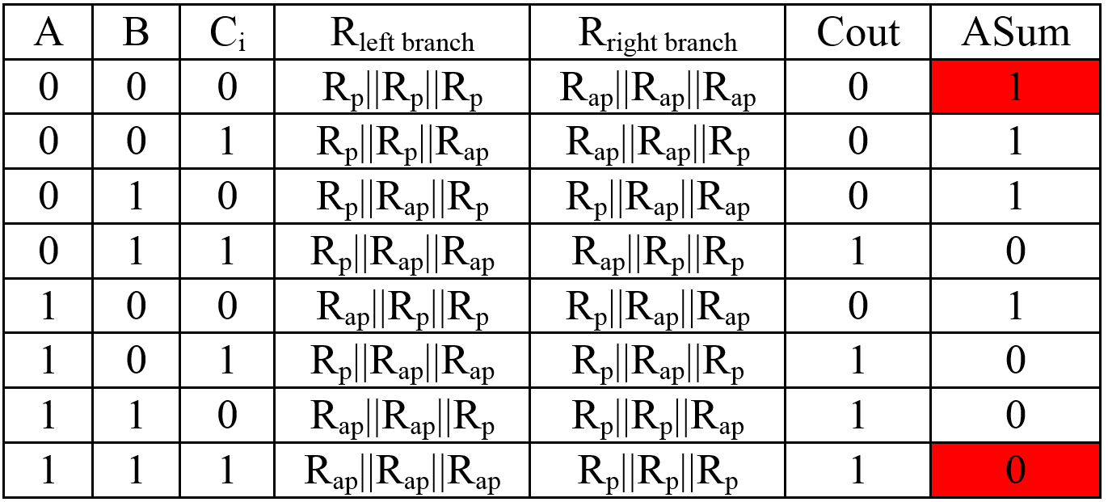

Slide 11
Proposed Accuracy-Adaptive AFMA:
1. Our design to extend the S-AMFA and SS-AMFA to work in either “accurate” or “approximate” mode based on a control signal (CS).
2. This accuracy-adaptive magnetic adder [called adaptive AMFA (A-AMFA)] works in approximate mode if the most significant input bits are “1,” meaning that lower order bits do not carry many important data.
3. A-AMFA deactivates the control signal whenever both most significant bits (MSBs) are “1.”
4. When any MSBs are “0,” the intermediate bits become important, and the adaptive full-adder functions accurately for the intermediate bits as well.

Slide 12
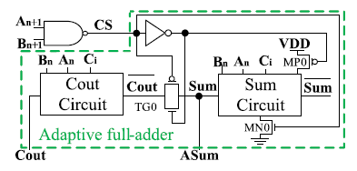

Slide 13

ADVANTAGES:
1. Delay is less
2. Performance is more

Slide 14

APPLICATIONS:
DSP Application
Image processing application

Slide 15
SOFTWARE REQUIREMENTS:
Xilinx 14.7
PROGRAMMIMG:
Verilog HDL

Slide 16
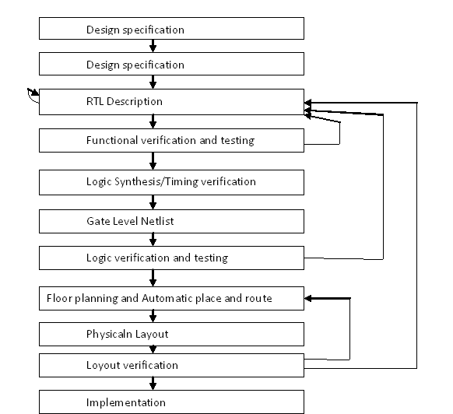
TYPICAL DESIGN FLOW:

Slide 17
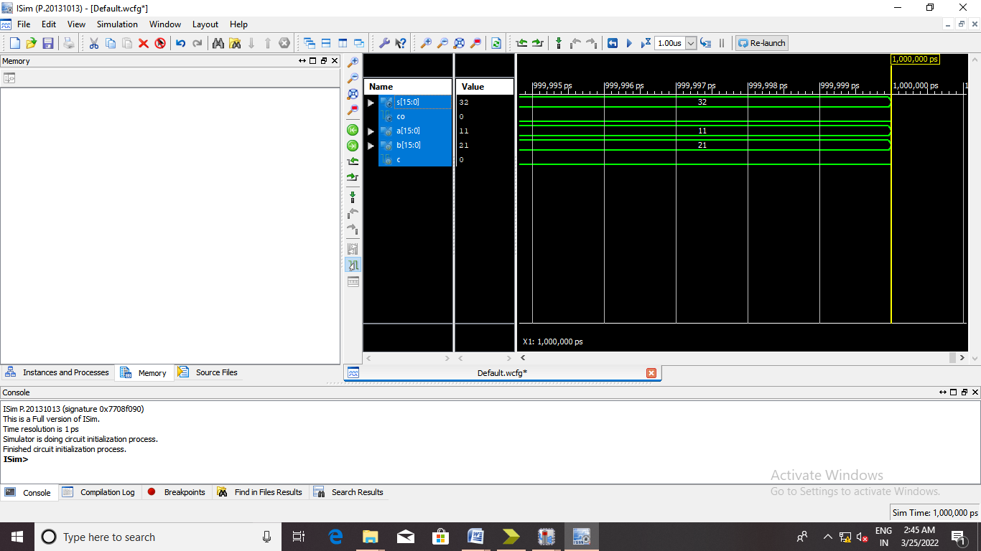
SIMULATION RESULT OF ADDER:

Slide 18
CONCLUSION:
Accuracy-adaptive spintronic adders offer a promising solution for low-power and high-speed image processing applications. With their ability to adapt to varying accuracy requirements, they can provide significant improvements in power consumption and processing speed. Further research and development can unlock their full potential and enable widespread adoption in various fields.

Slide 19
THANK YOU

